Slide 1
JavaScript Unit Testing
Using the Jest testing framework
@twitter

Slide 2
Jest – JavaScript Testing Framework
“Jest is a delightful JavaScript Testing Framework with a focus on simplicity.”
It allows you to write tests with an approachable, familiar and feature-rich API that gives you results quickly.
Jest is well-documented and requires little configuration
It works with projects that use: Babel*, TypeScript, Node*, React, Angular, Vue etc.

Slide 3
How does Jest work?
Looks for files with a “.test.js” extension (.spec can also be used)
Looks to package.json for jest configuration. (Or, alternatively, a separate jest config file)

Slide 4
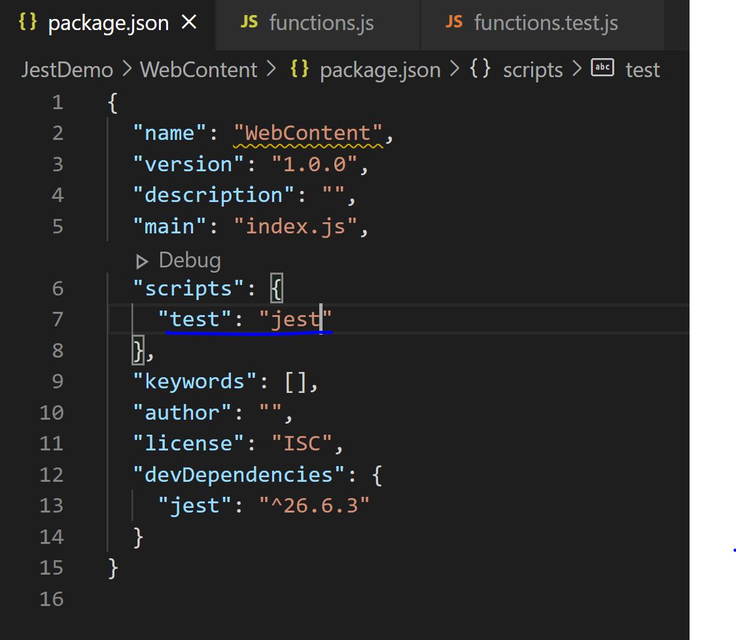
Setup
Open a terminal
Cd to web application directory
npm init –y
Creates a package.json file
Edit this to run jest when the test script is ran
npm install –D jest
Installs jest as a development dependency

Slide 5
describe() – It is a suite of Test scripts that gives an outer description for the test suite
test() – It is the smallest unit test case that is written to be executed. String in quotes represents the test name
expect() – It is an assertion. Every test() statement has an expect() function which takes a value and expects a return in true form.

Slide 6
Jest – Writing a test
Structure of a Jest test
test(string: ‘this is the description of the test’, () => {
//This is your test method body
.
**some logic**
.
expect(actual).someMatcher(expected);
});
https://jestjs.io/docs/en/using-matchers
https://jestjs.io/docs/en/expect

Slide 7
Test example
test(‘Test that 1 + 2 = 3’, () => {
const num1 = 1;
const num2 = 2;
const result = num1 + num2; //3
expect(result).toBe(3);
});
assertion actual matcher expected

Slide 8
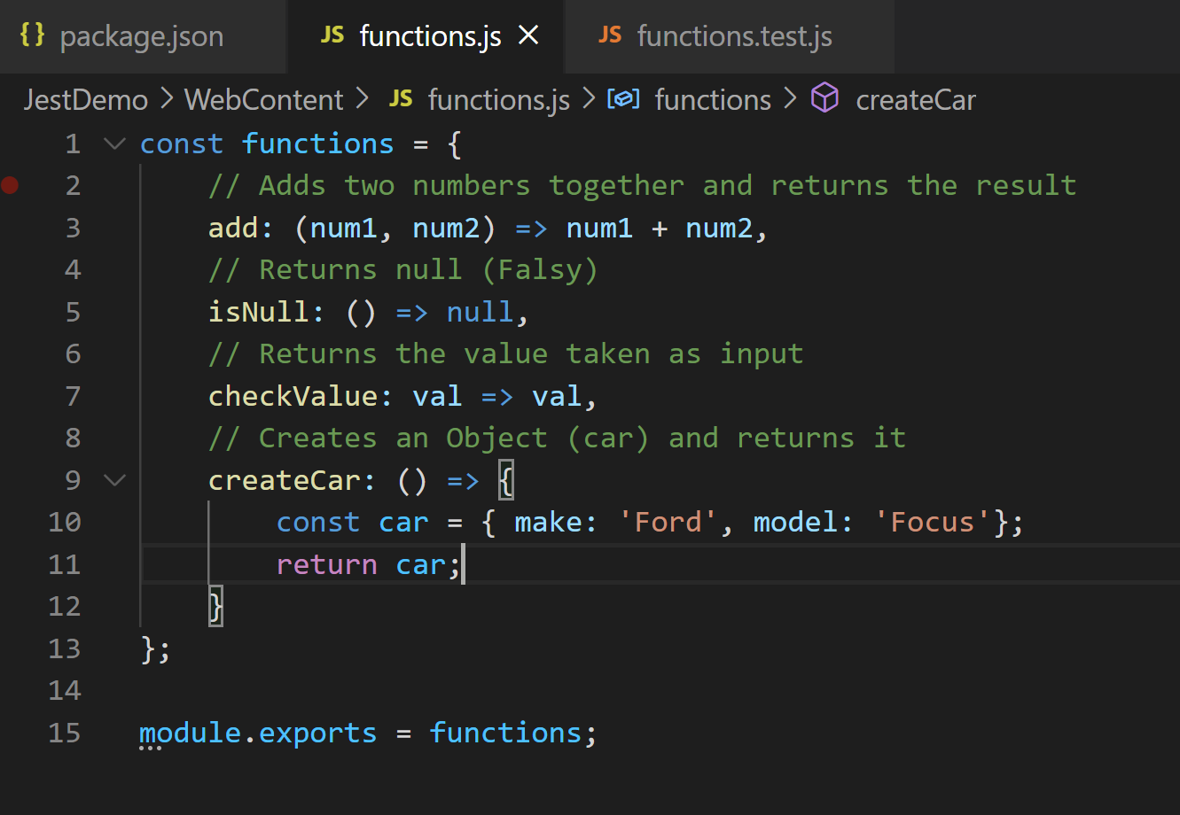
JavaScript file to test
Filename: functions.js
Contains a number of functions in which we can test.
This will cover testing:
Values (toBe)
“Falsy” values (0, undefined, null)
Objects (toEqual)
Arrays

Slide 9
Test example
Testing functions.js

Slide 10
Other Tools
Maven
Requires a frontend-maven-plugin to install Node and Npm
Run the test script
https://github.com/eirslett/frontend-maven-plugin
Babel
A JavaScript compiler which will convert code to a backwards compatible version of JavaScript
Webpack
Manages resources, styles and compilation
“Bundles” our code into a single JS file
When webpack processes your application, it internally builds a dependency graph which maps every module your project needs and generates one or more bundles.
Helps to make our testing environment and front-end work together

Slide 11
SonarCloud
Adding coverage to SonarCloud
Run jest with “—coverage” argument
This will generate a lcov.info file that Sonar will read
Make Sonar aware of where the coverage report is located
<sonar.javascript.lcov.reportPaths>${project.basedir}/target/code-coverage/lcov.info</sonar.javascript.lcov.reportPaths>
Make Sonar aware of where the Node executable is located
<sonar.nodejs.executable>${project.basedir}/src/main/resources/webapp/node/node</sonar.nodejs.executable>
Include JS files. Exclude any test folders, jQuery, resources (css, images etc.).

